Slide 1
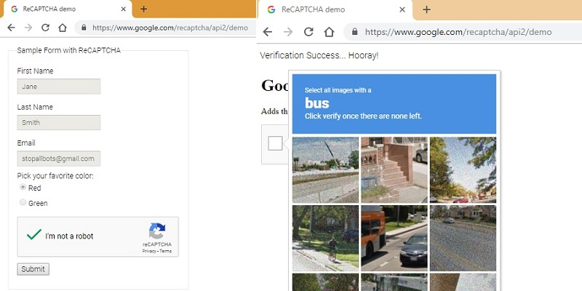
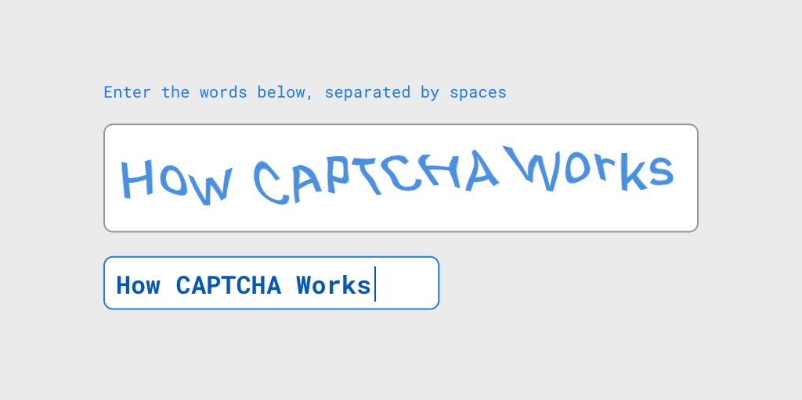
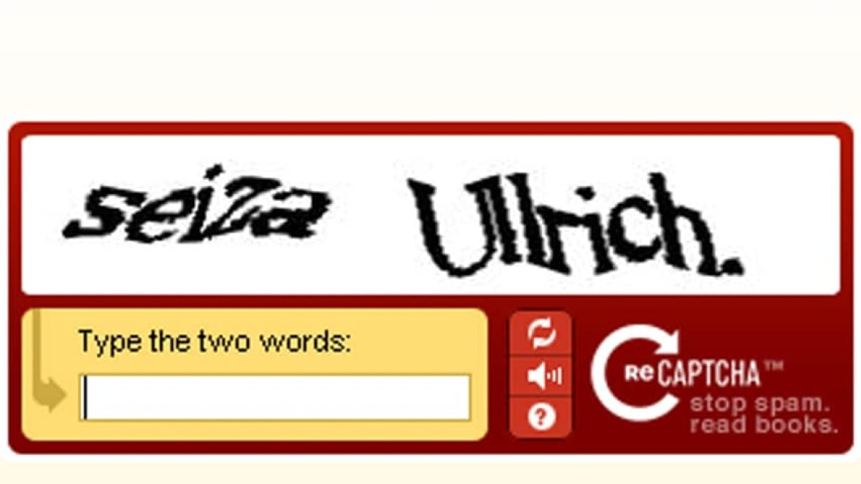
"Completely Automated Public Turing test to tell Computers and Humans Apart"

Slide 2
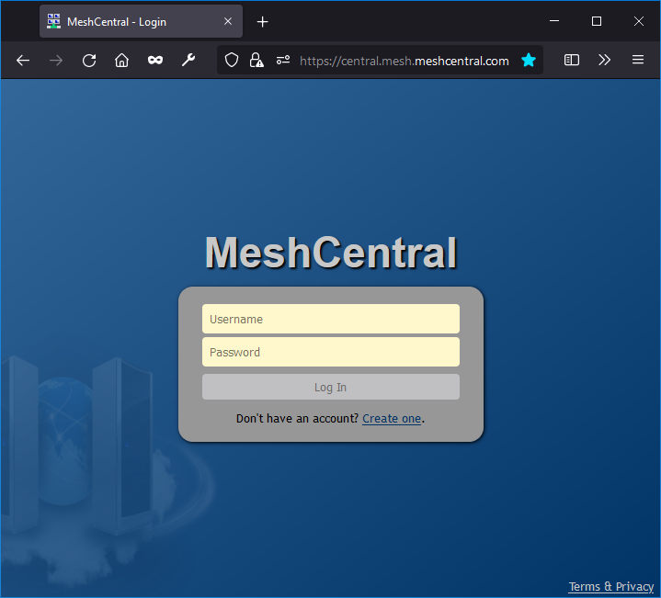
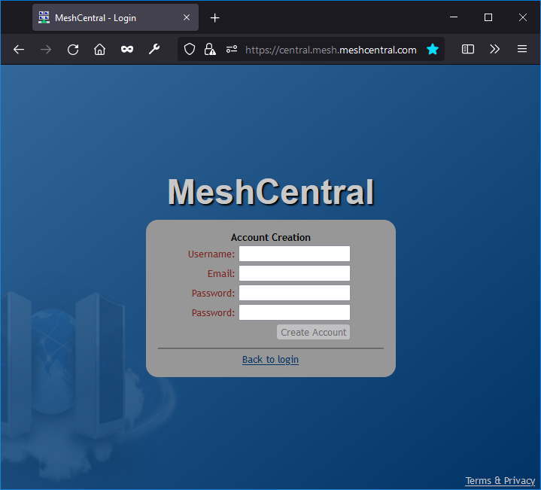

Slide 3

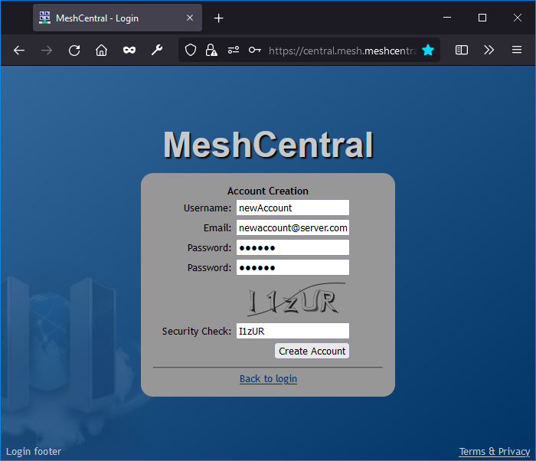
MeshCentral
"domains": {
"": {
"newAccounts": true,
"newAccountsCaptcha": true }
}

